Slide 1
CRM DATA INTERN Case Study
Presented by Loris Lindemann

Slide 2
Activity 1
Presentation of my processed Excel file
Tools used:
Python
Jupyter Notebook

Slide 3
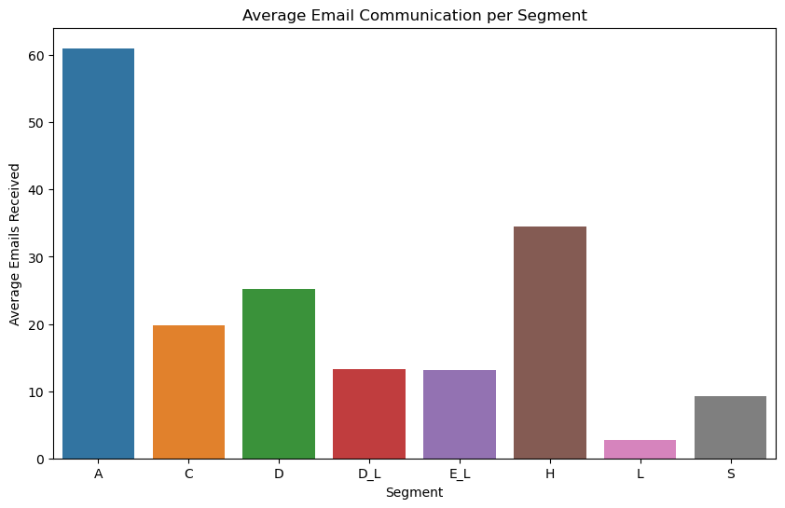
Activity 2
Segment A receives the highest number of emails
Segment A receives nearly twice as many emails as Segment H, the second most emailed group
Lower email volumes for Segment L and S

Slide 4
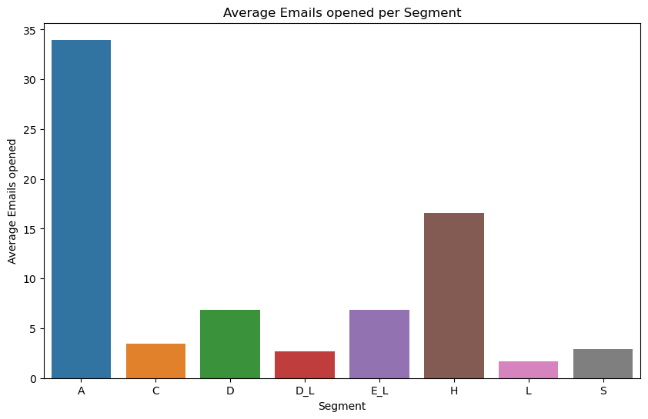
Activity 2
Segment A not only receives but also opens the most emails
The gap in email communication between Segment A and Segment H remains substantial
Approximately 50% of the emails sent to Segment A go unopened
Segments C, D, D_L, and S have even higher non-open rates, indicating potential issues with engagement

Slide 5
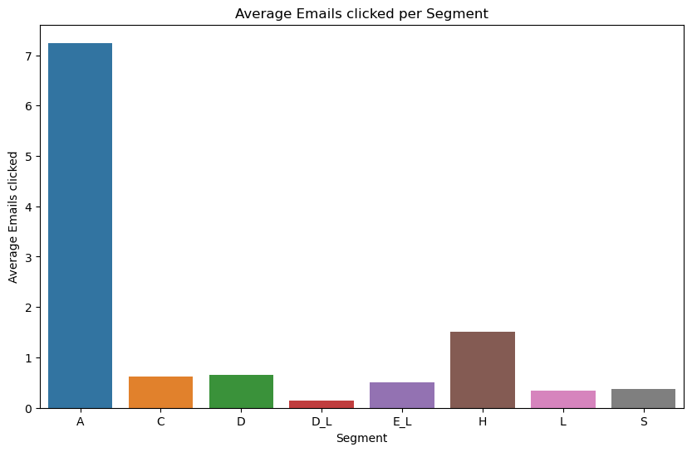
Activity 2
Segment A leads in the average number of emails clicked
Approximately 80% of the opened emails from Segment A are not clicked
Segment A has a 12% conversion rate from email received to emails clicked
Except Segment A and H, all other Segments have clicked per average on one email

Slide 6
Activity 2
How do different segments react to CRM communications?
Segment A exhibits the highest level of interaction with CRM communications across all three metrics
While Segment H shows the second-highest engagement levels, it experiences at least a 50% drop in interactions compared to Segment A across the three metrics
Engagement levels in other segments are significantly lower than Segment A

Slide 7
Activity 2
Which segment is the most responsive to communications?
Segment A is not only the most targeted but also the most responsive, showing robust engagement from reception to interaction with email content
The conversion rate from emails received to emails clicked from Segment A is with 12% the highest and has the highest drop-off between the events emails opened and emails clicked

Slide 8
Activity 2
Additional Insights:
There is a significant drop-off in engagement from emails received to emails clicked in all segments, which could point to content or offer misalignment with the audience’s interests or needs
The highest drop-off is between the events emails opened and emails clicked, indicating an opportunity to optimize the email content to maintain interest

Slide 9
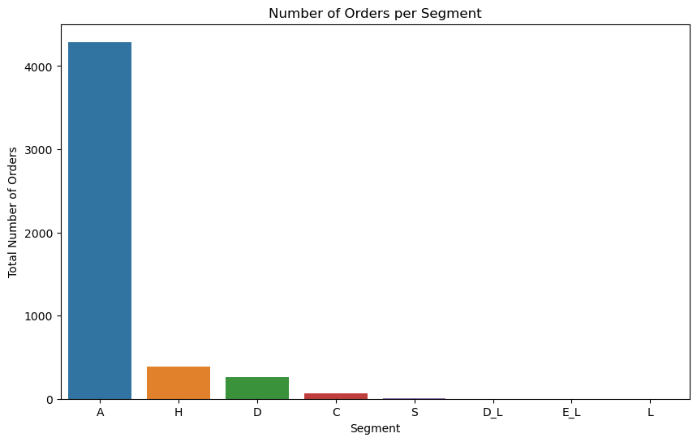
Activity 3
Segment A is again the most significant contributor to sales, with its total number of orders far exceeding other segments
Segment H is still second and there is a huge gap between the other segments
Segment D_L, E_L and L don’t have any orders

Slide 10
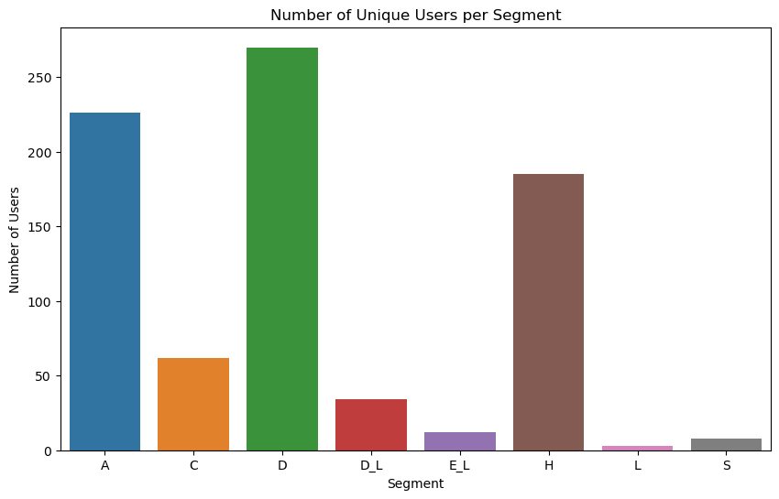
Activity 3
Segment D has the highest unique consumer ID’s, but the third highest order amount
The relation of unique ID’s between A and H is a lot narrower than with the number of orders

Slide 11
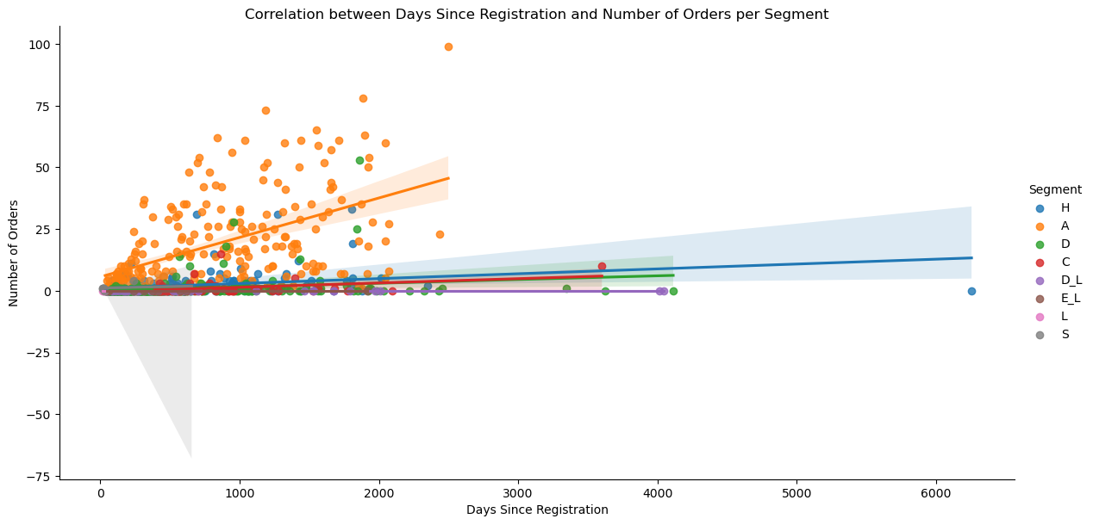
Activity 3
There is a positive correlation between days since registration and number of orders
This indicates the importance of keeping the consumer to achieve more orders in the future

Slide 12
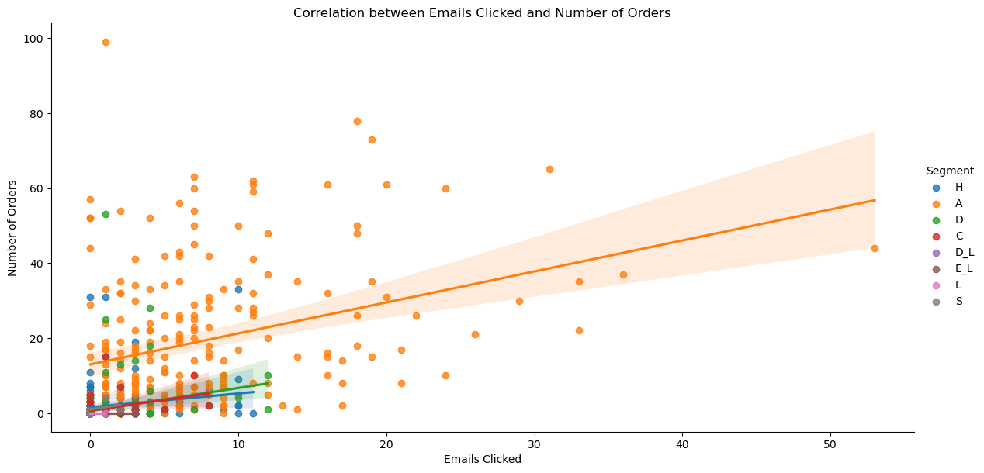
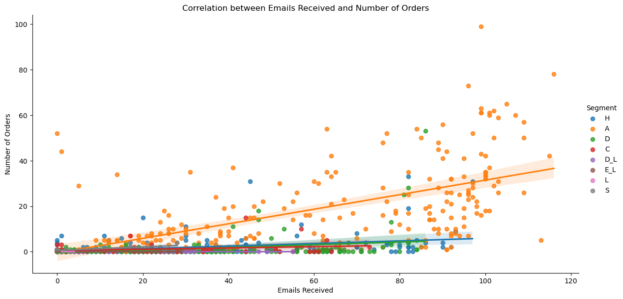
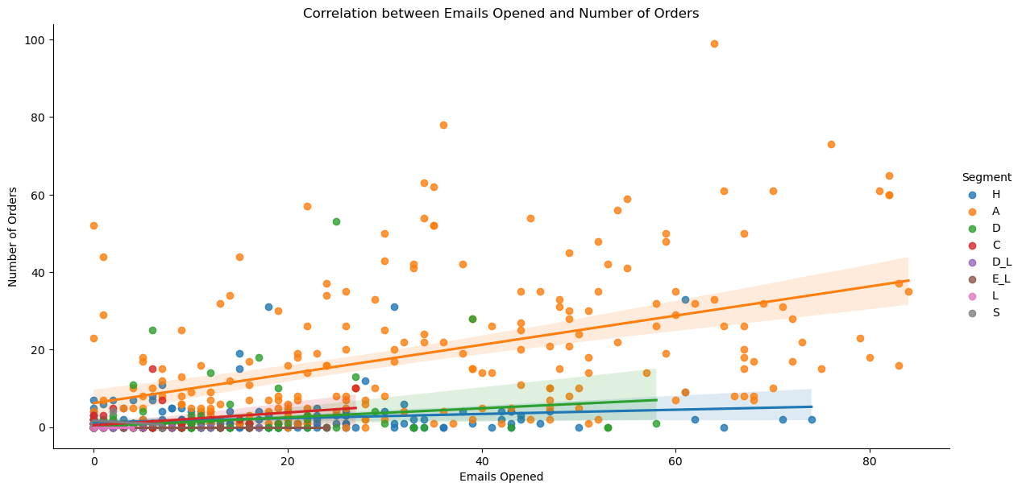

Slide 13
Activity 3
There is a strong correlation between CRM communications and the volume of orders for Segment A, underscoring the effectiveness of current CRM strategies with this segment
The less pronounced correlation for other segments suggests an opportunity to reevaluate and change the email content and overall CRM strategy to better resonate with these groups

Slide 14
Activity 3
Recommendations to the CRM Team
Continue the high frequency of communications with Segment A but maybe increase personalization based on consumer data to maintain and potentially improve engagement rates
For segments with lower engagements reevaluate and change the email content. These could include special offers or reminder of unused promo codes
Increase the volume of communications to under-engaged segments, ensuring the ratio of emails received to unique IDs is optimized to maximize exposure without causing fatigue
Regularly perform A/B testing to determine the most effective strategies

